Slide 1


3D Visualization with the ArcGIS API for JavaScript
Kristian Ekenes
Raluca Nicola
2018 Esri DEVSummit Conference | Palm Springs, CA

Slide 2






Kristian Ekenes
Raluca Nicola
Product Engineer JS API
Product Engineer JS API
Data visualization, Smart Mapping, Arcade
Data visualization, 3D
Redlands, California
Zurich, Switzerland
Notes:
Not sure if this slide is worth it. We present ourselves anyway

Slide 3
Discover how to visualize geodata in a meaningful way in 3D using ArcGIS API for JavaScript
Notes:
Motivation – why are they here

Slide 4
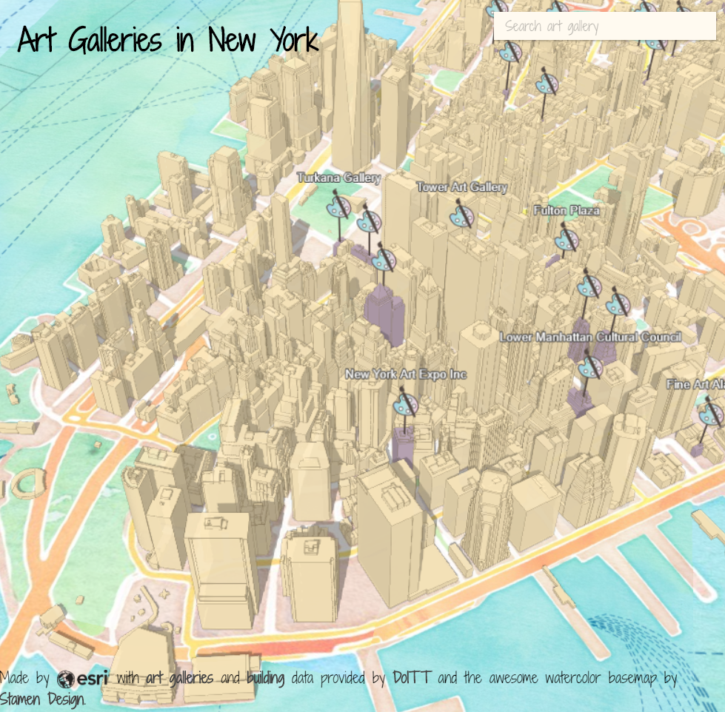
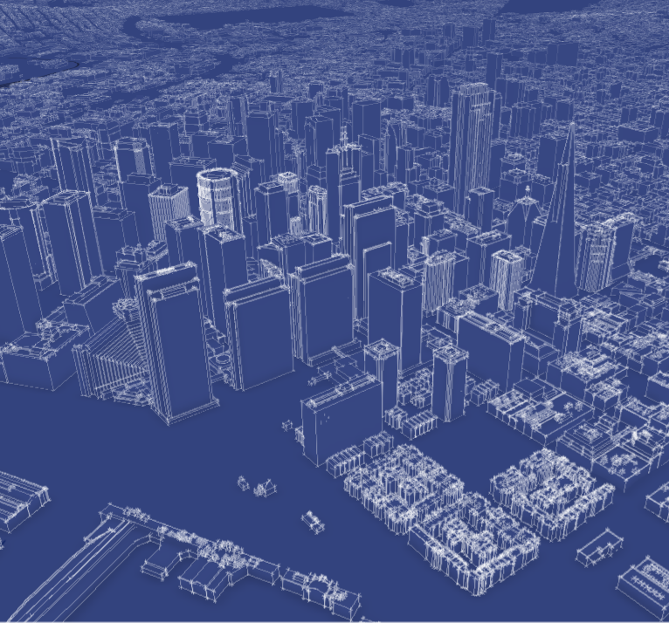
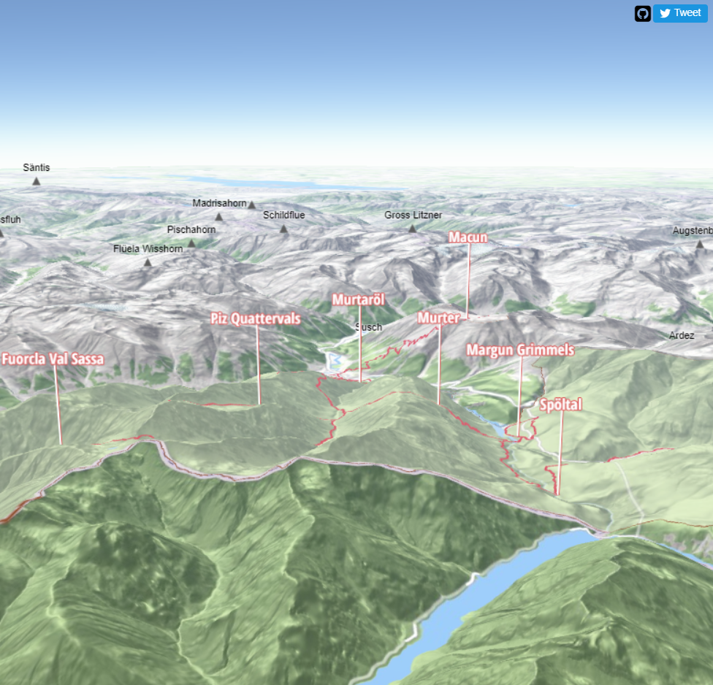
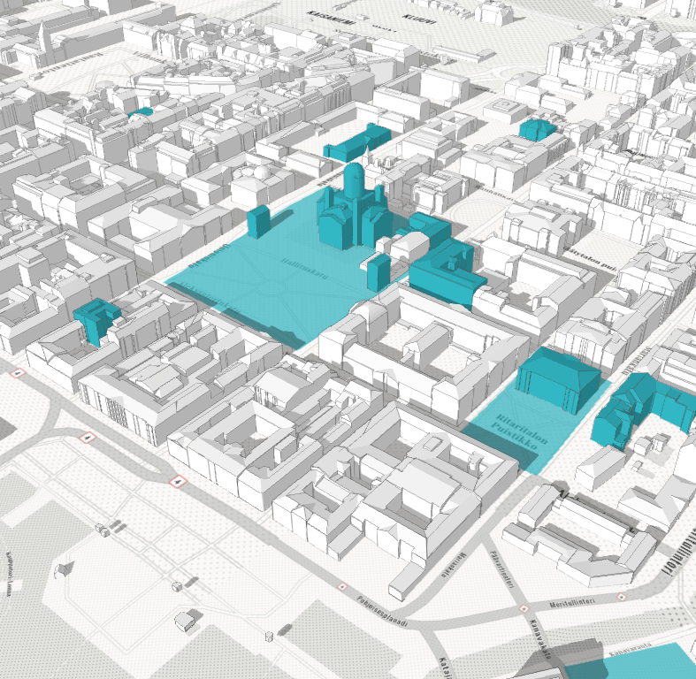
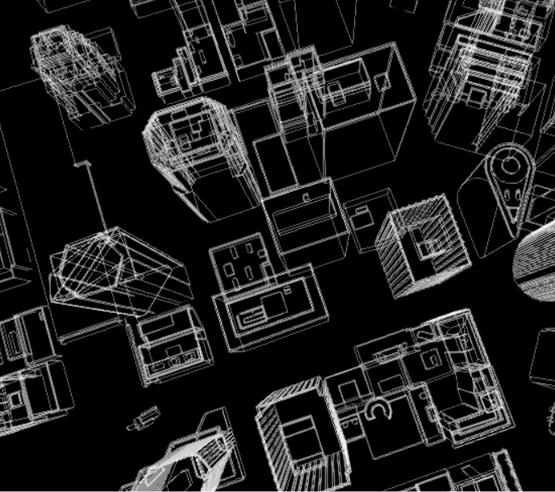
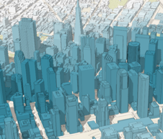
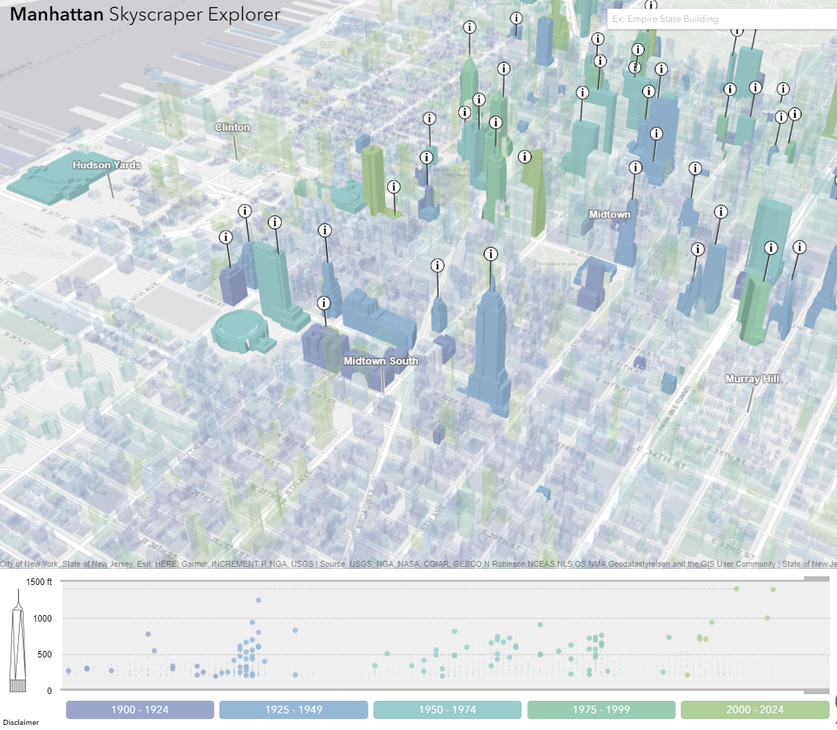
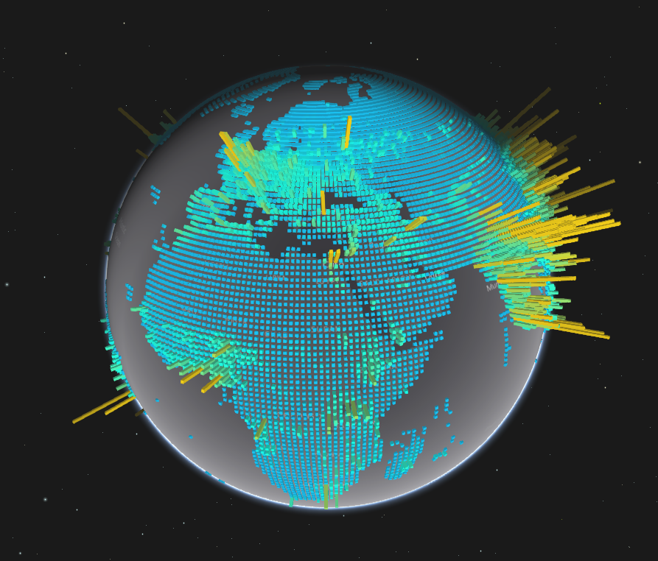
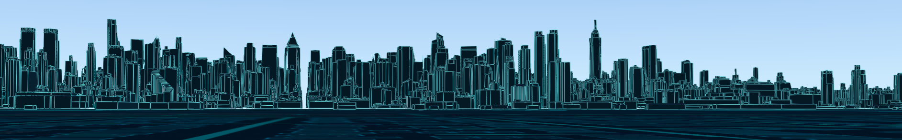
Notes:
Motivation – why are they here
They’ll learn how to visualize data like this

Slide 5

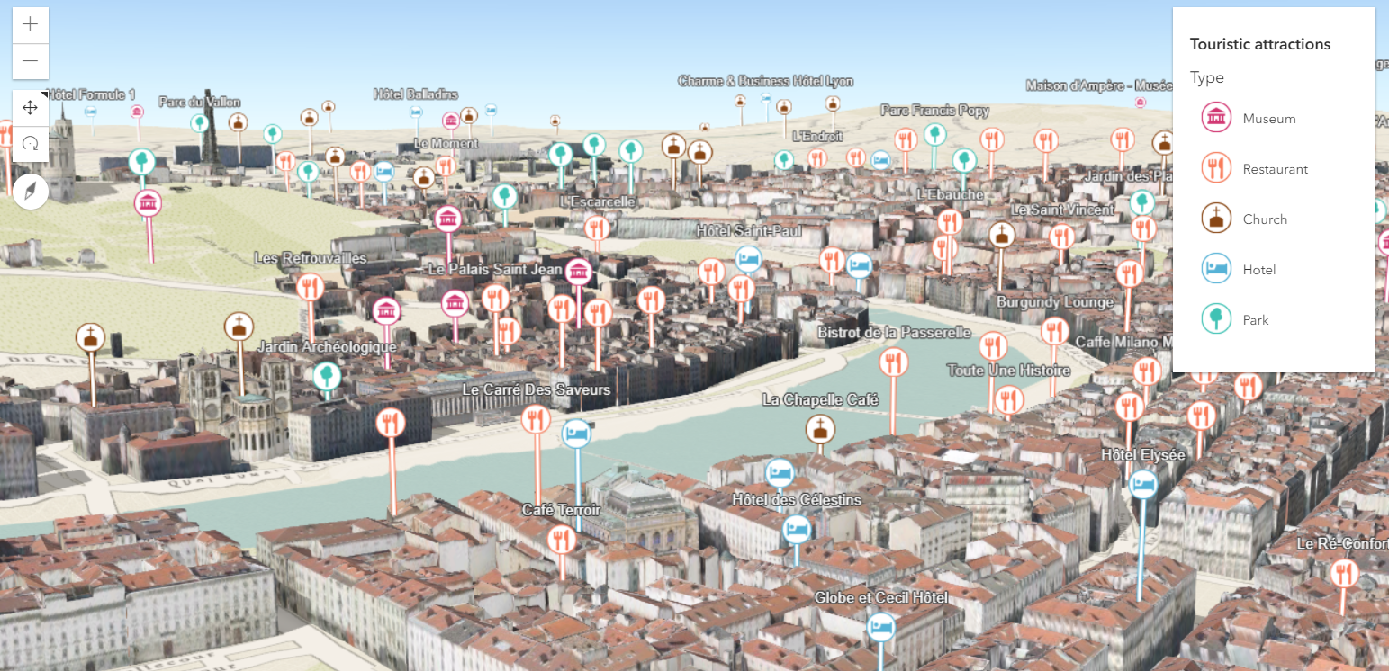
Points of interest in a city
Notes:
Intro – what we will show

Slide 6
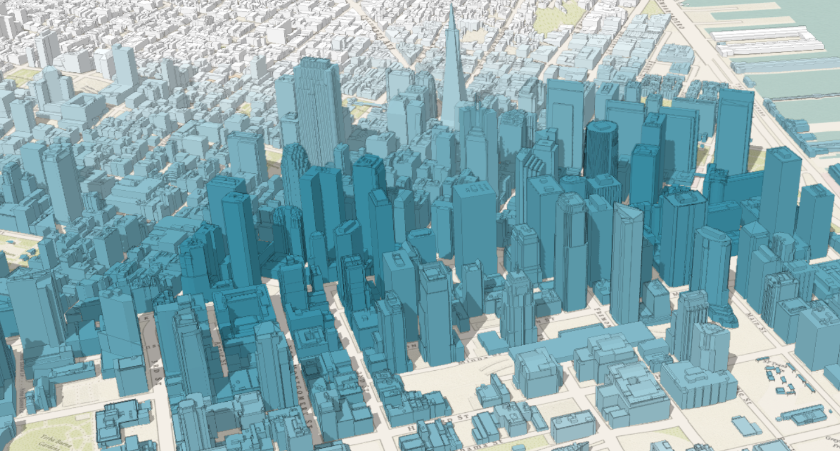
City thematic visualization
Notes:
Intro – what we will show

Slide 7
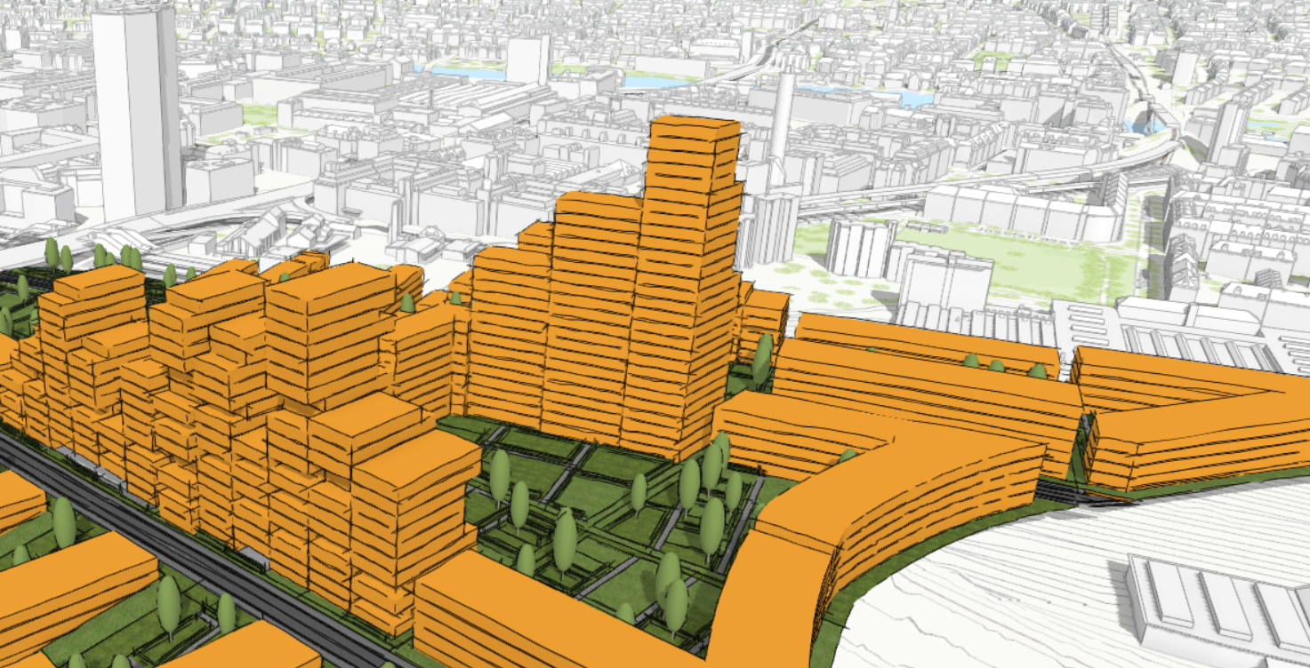
Urban development
Notes:
Intro – what we will show

Slide 8
Three use cases
- hands on demos -
Sneak peak into the future
Visualization API
- basics -
Symbols & renderers
- general overview -
5 min
20 min
10 min
5 min
Notes:
What’s the approach for learning how to visualize data

Slide 9

Visualization API
Basic patterns

Slide 10
layer
var layer = new FeatureLayer({
renderer: new SimpleRenderer({
symbol: new PointSymbol3D({
symbolLayers: [new IconSymbol3DLayer({…})]
})
}),
elevationInfo: {
mode: "relative-to-scene"
},
labelingInfo: [{
symbol: new LabelSymbol3D({
symbolLayers: [new TextSymbol3DLayer({…})]
})
}]
});
renderer
symbol
symbolLayers

Slide 11
var layer = new FeatureLayer({
renderer: new SimpleRenderer({
symbol: new PointSymbol3D({
symbolLayers: [new IconSymbol3DLayer({…})]
}),
visualVariables: [{
type: "size",
field: "TOTPOP_CY",
normalizationField: "SQMI",
stops: [{
value: 4000,
size: 6
},
{
value: 23000,
size: 40
}]
}]
});
renderer
symbol
symbolLayers
visualVariables
for numeric continuous visualizations

Slide 12

Data-driven visualization
Renderers & Visual Variables
Field value(s) TOTAL_POP
Arcade expression Round( ($feature.BACHELOR + $feature.MASTER) / $feature.POP_25UP) );
JavaScript function function (graphic){ return graphic.attributes.POP_DENSITY; }

Slide 13
layer
var layer = new FeatureLayer({
renderer: new SimpleRenderer({
symbol: new PointSymbol3D({
symbolLayers: [new IconSymbol3DLayer({…})]
})
}),
elevationInfo: {
mode: "relative-to-scene"
},
labelingInfo: [{
symbol: new LabelSymbol3D({
symbolLayers: [new TextSymbol3DLayer({…})]
})
}]
});
elevationInfo
mode

Slide 14
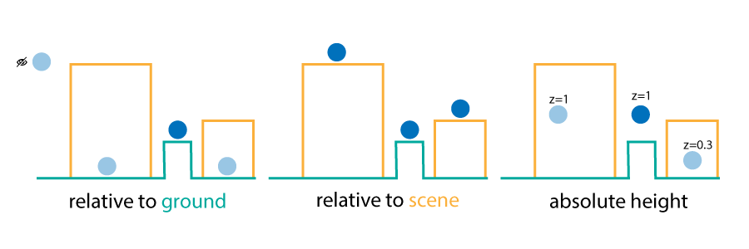
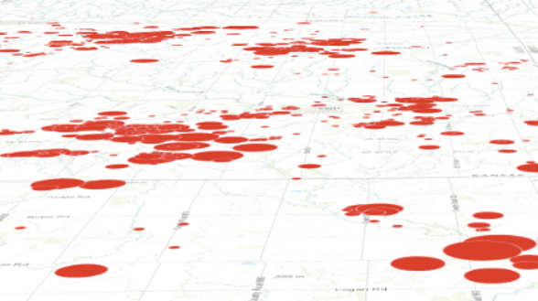
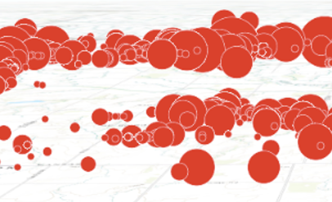
layer
elevationInfo
mode
on the ground
relative to ground

Slide 15
layer
var layer = new FeatureLayer({
renderer: new SimpleRenderer({
symbol: new PointSymbol3D({
symbolLayers: [new IconSymbol3DLayer({…})]
})
}),
elevationInfo: {
mode: "relative-to-scene"
},
labelingInfo: [{
symbol: new LabelSymbol3D({
symbolLayers: [new TextSymbol3DLayer({…})]
})
}]
});
labelingInfo
symbol
symbolLayers

Slide 16
Three use cases
Hands on demos

Slide 17
Points of interest in a city
Demo time

Slide 18
Smart mapping
Demo time

Slide 19
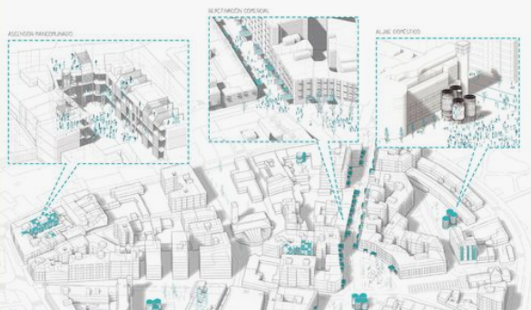
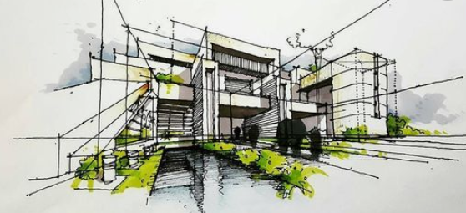
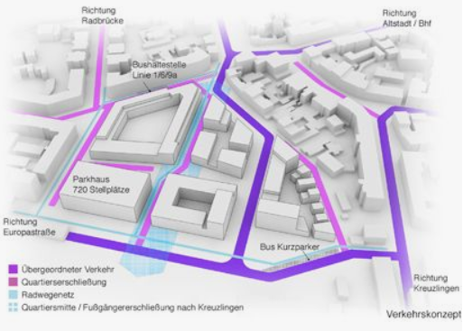
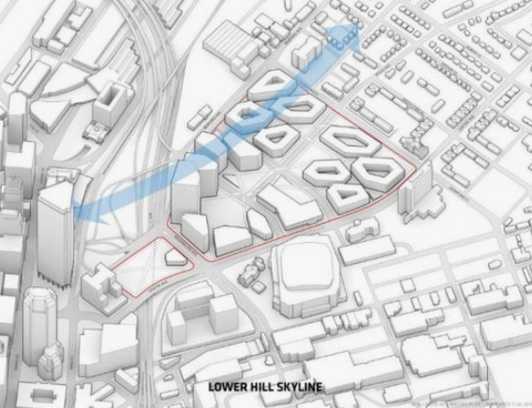
Notes:
Intro – what we will show

Slide 20
Urban development
Demo time

Slide 21
Symbols and Renderers
General overview

Slide 22
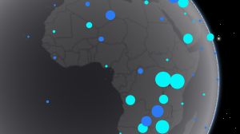
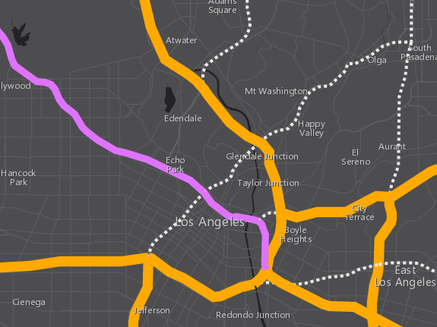
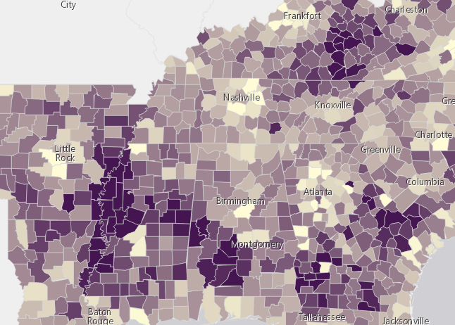
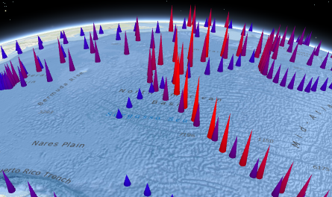
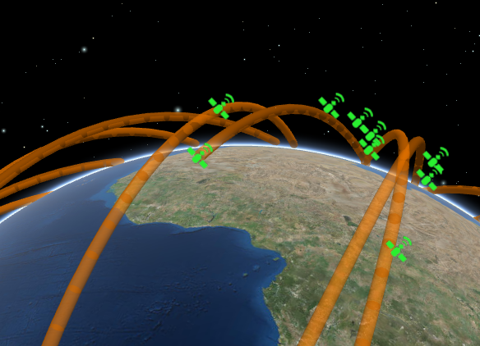
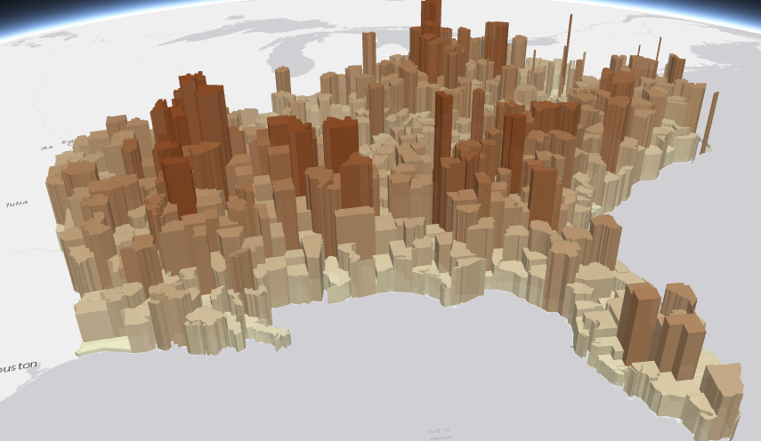
Symbols
PointSymbol3D
LineSymbol3D
PolygonSymbol3D
IconSymbol3DLayer
LineSymbol3DLayer
FillSymbol3DLayer
Flat
- Screen size units (pt, px)
- Graphics are in screen space
PathSymbol3DLayer
ExtrudeSymbol3DLayer
Volumetric
- Real world units (feet, meter)
- Graphics are in real world space
ObjectSymbol3DLayer

Slide 23
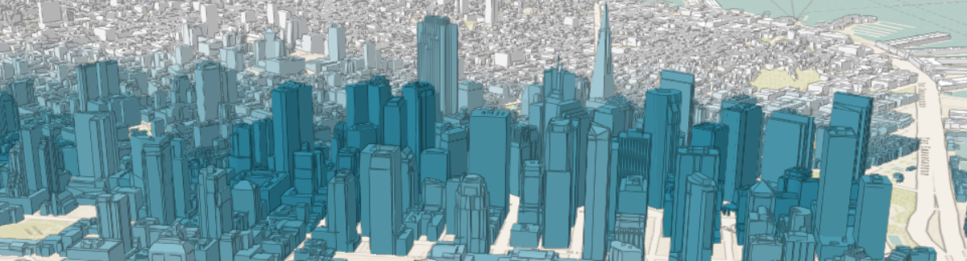
Symbols
MeshSymbol3D
FillSymbol3DLayer

Slide 24
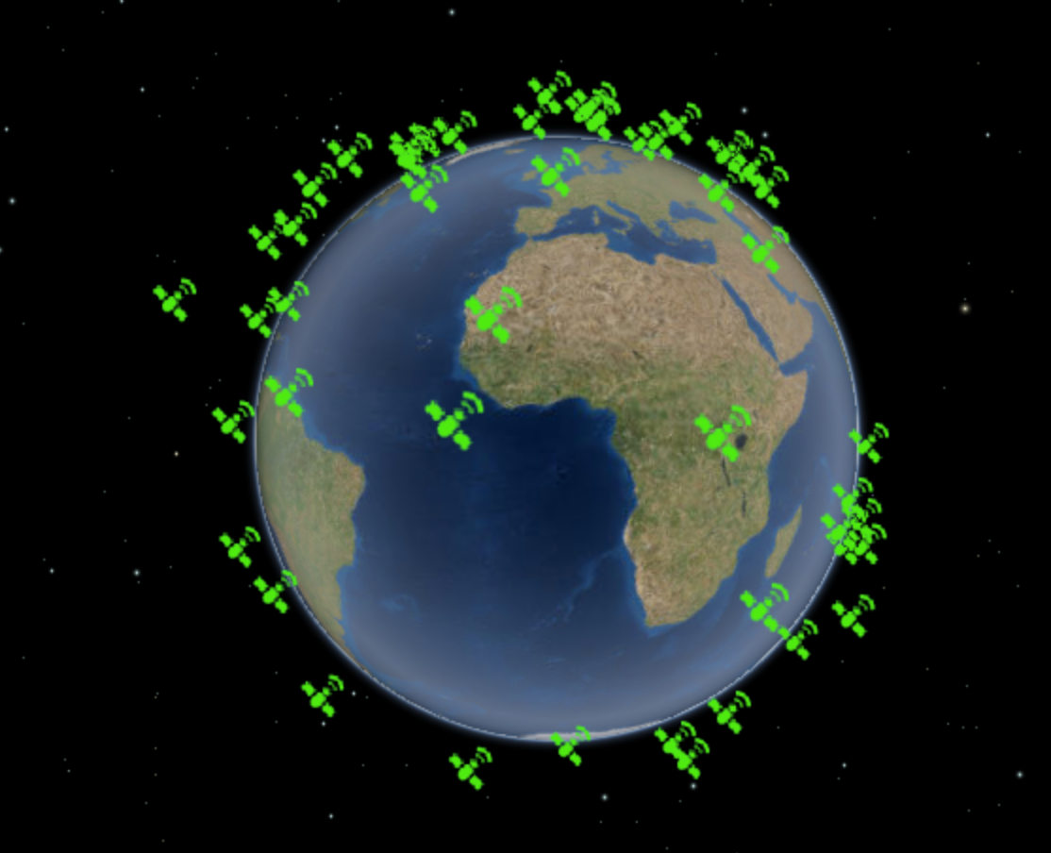
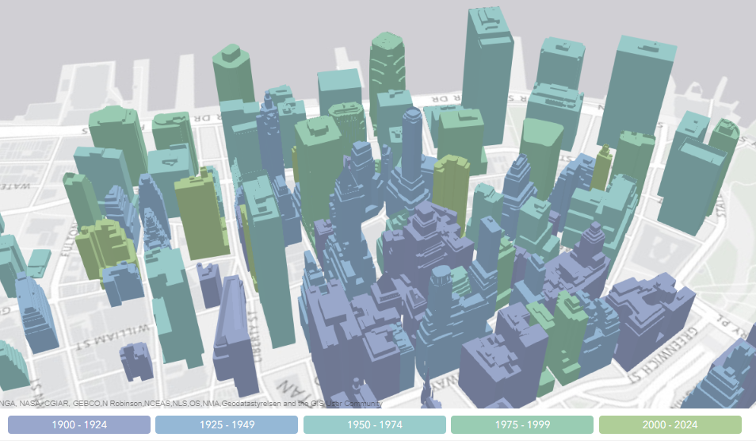
Renderers
SimpleRenderer
UniqueValueRenderer
ClassBreaksRenderer

Slide 25
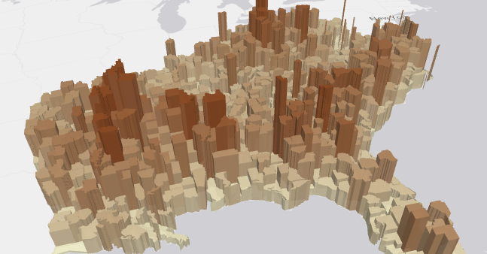
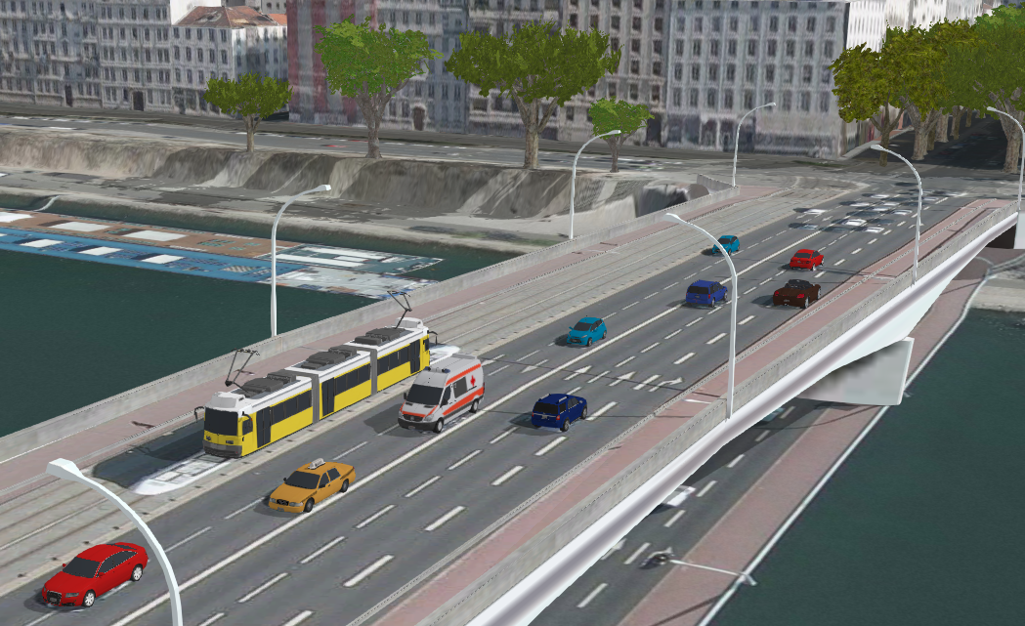
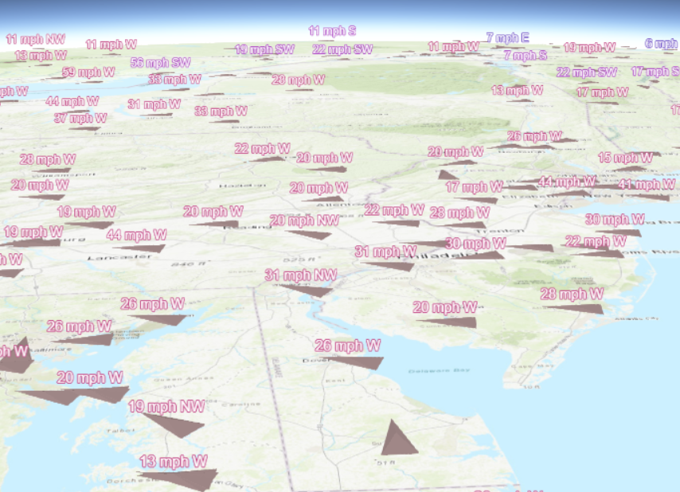
Multivariate mapping with visual variables
visualVariables - only for continuous numerical visualization
Color
Size
Rotation
Opacity

Slide 26
Sneak peak into the future

Slide 27
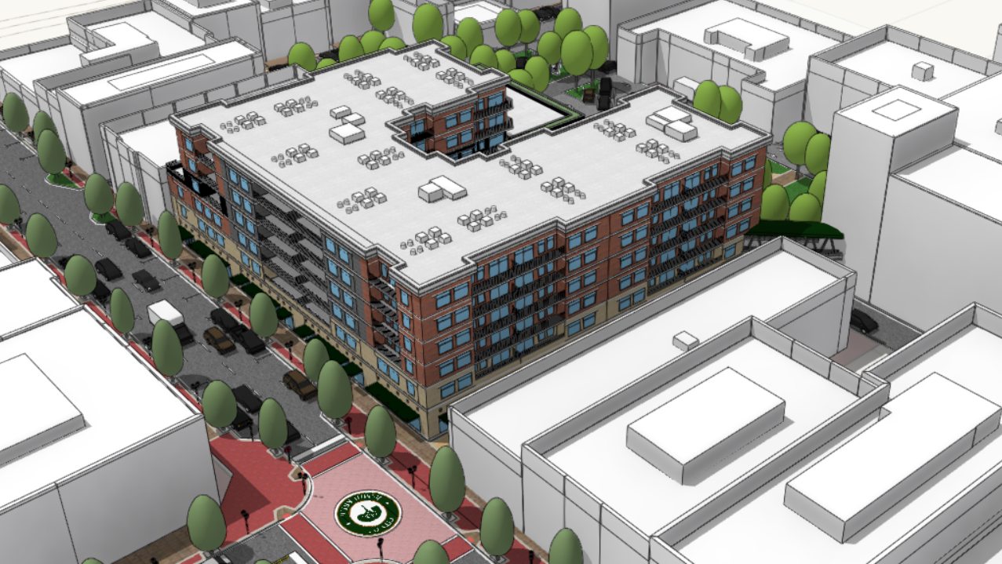
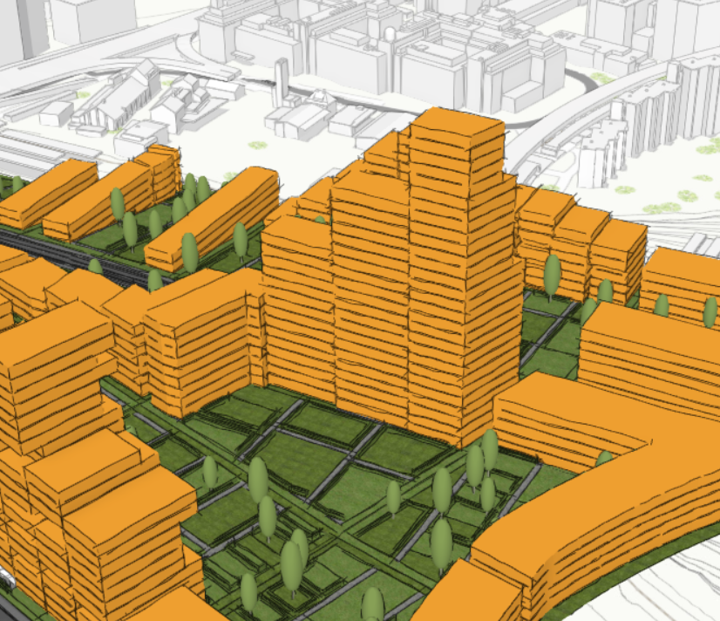
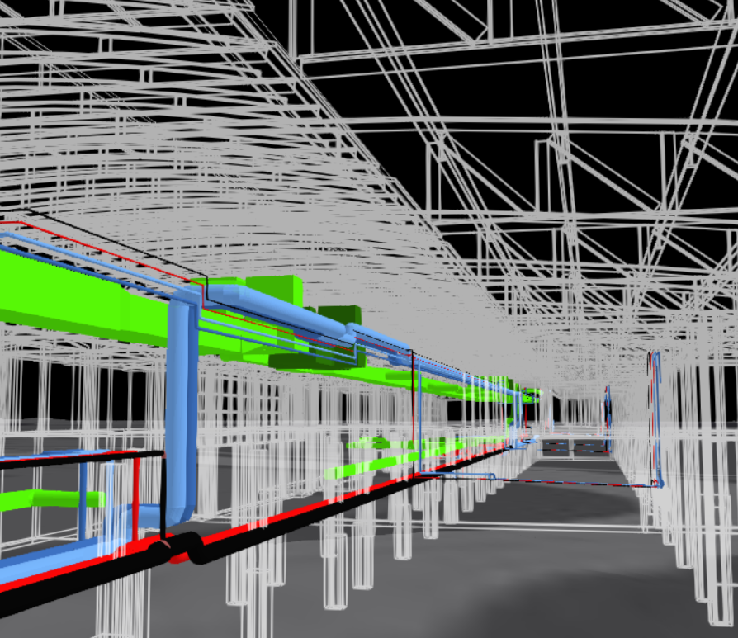
Edge rendering – already in 4.7

Slide 28
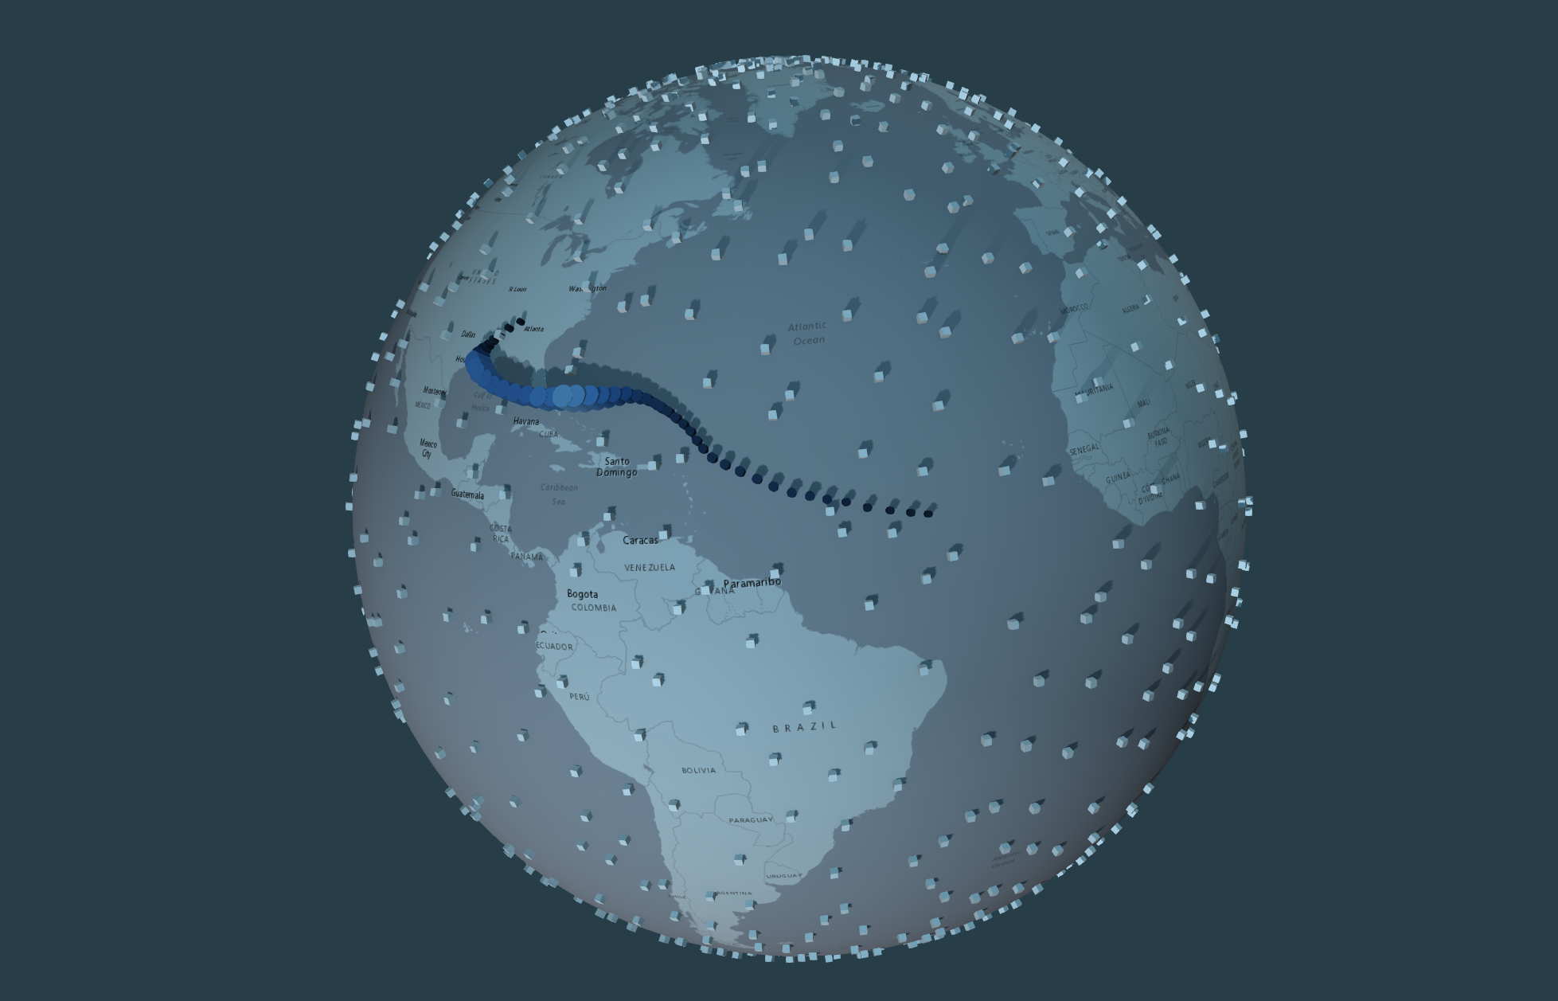
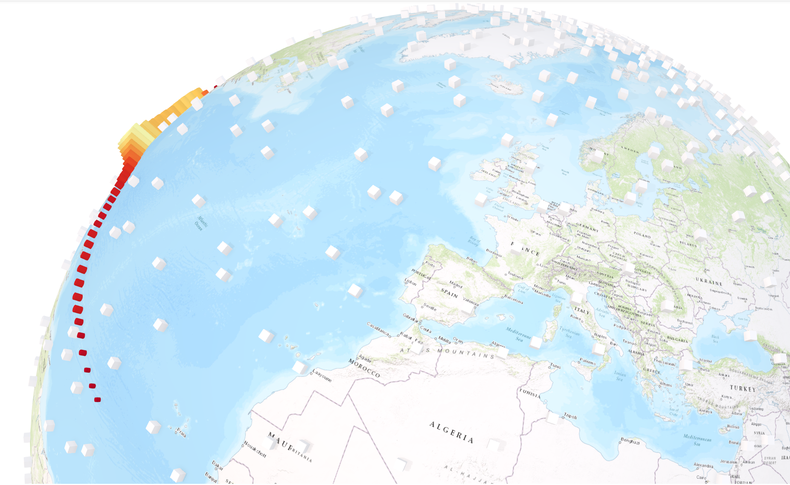
Lighting conditions

Slide 29
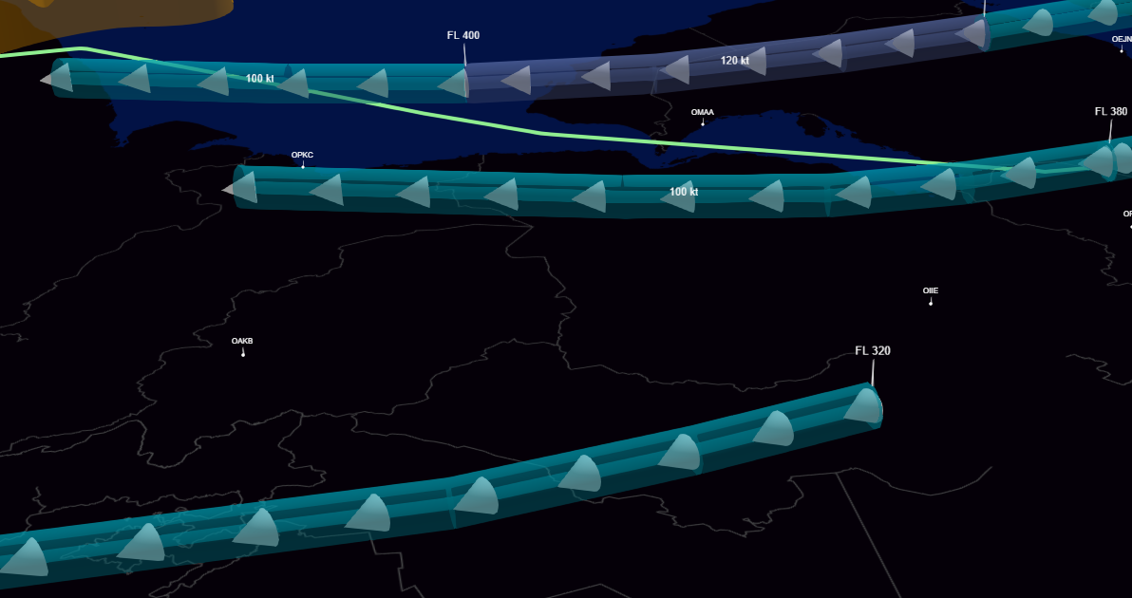
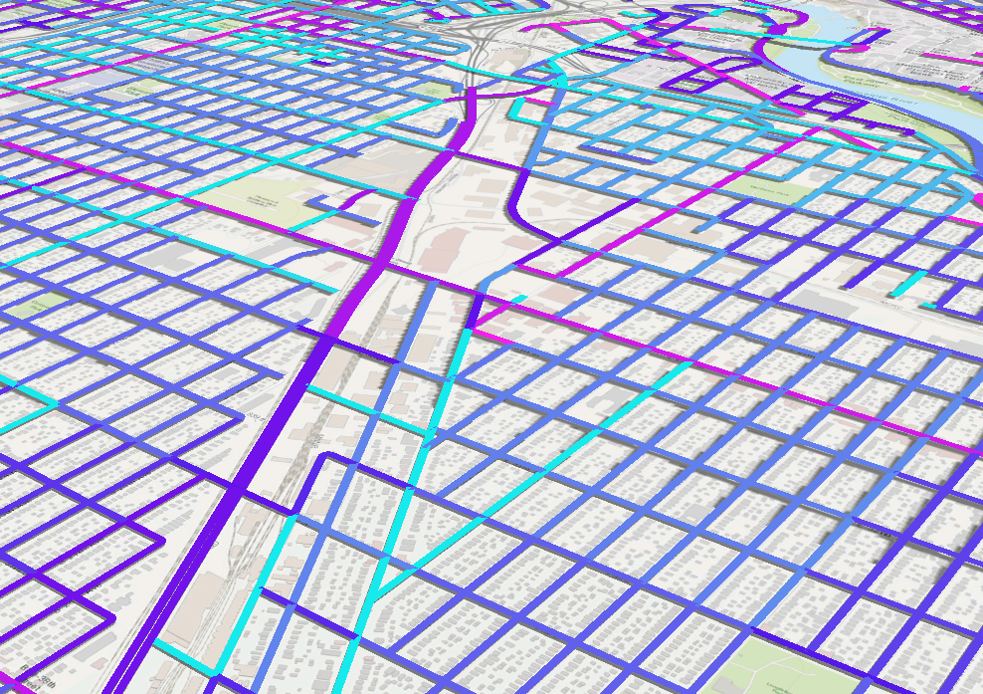
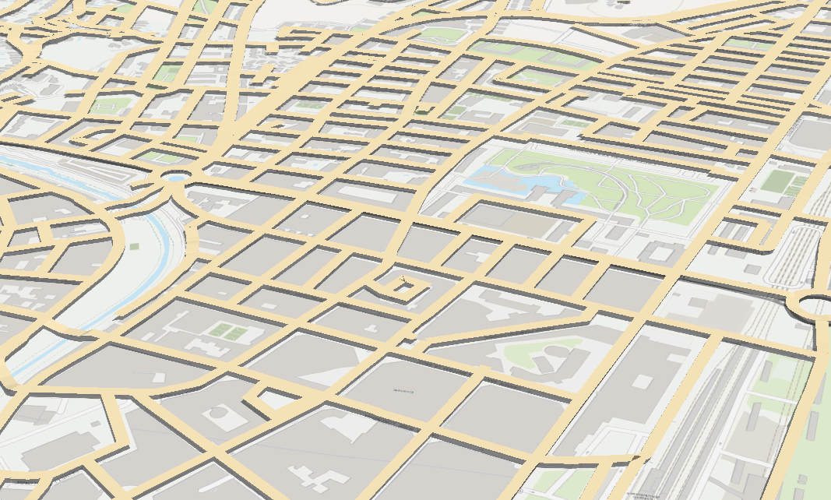
Line styles

Slide 30



